Slide 1
CSC 222: Computer Organization & Assembly Language
6 – Interrupt Driven IO

Slide 2
Outline
Interrupts
Input Output Instructions
Sample Programs
References
Chapter 3, 4, Ytha Yu and Charles Marut, “Assembly Language Programming and Organization of IBM PC”
Chapter 3, Assembly Language for Intel Based-Computers

Slide 3
Interrupts

Slide 4
Interrupts – Changing Program Flow
Mechanism by which other modules (e.g. I/O) may interrupt normal sequence of processing
Program
  e.g. overflow, division by zero
Timer
  Generated by internal processor timer
  Used in pre-emptive multi-tasking
I/O
  from I/O controller
Hardware failure
  e.g. memory parity error

Slide 5
Interrupt Cycle
Added to instruction cycle
Processor checks for interrupt
  Indicated by an interrupt signal
If no interrupt, fetch next instruction
If interrupt pending:
  Suspend execution of current program
  Save context
  Set PC to start address of interrupt handler routine
  Process interrupt
  Restore context and continue interrupted program

Slide 6

Transfer of Control via Interrupts

Slide 7

Instruction Cycle with Interrupts

Slide 8
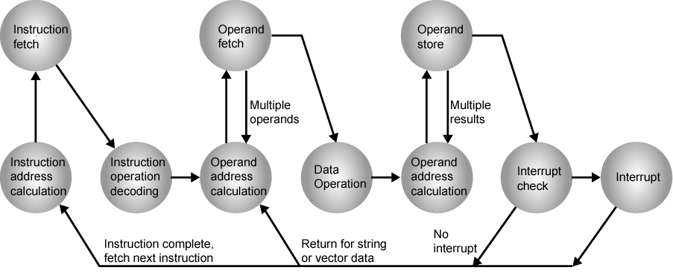
Instruction Cycle (with Interrupts) - State Diagram

Slide 9
Multiple Interrupts
Disable interrupts
  Processor will ignore further interrupts whilst processing one interrupt
  Interrupts remain pending and are checked after first interrupt has been processed
  Interrupts handled in sequence as they occur
Define priorities
  Low priority interrupts can be interrupted by higher priority interrupts
  When higher priority interrupt has been processed, processor returns to previous interrupt

Slide 10

Multiple Interrupts - Sequential

Slide 11
Multiple Interrupts – Nested

Slide 12
Input and Output Instructions

Slide 13
I/O Ports
I/O Devices are connected to the computer through I/O circuits.
Each circuit contains several registers: I/O Ports
Some ports used for data while others are used for commands.
Transfer Points between CPU and I/O device.
Each I/O port:
  has an address “I/O Address”
  Is connected to the bus system
I/O Address can only be used with Input / Output instructions.

Slide 14
I/O Port Addresses
The 8086/8088 supports 64 KB of I/O Port
Usage vary among computer models
Some Common I/O Ports:
Port Address | Description
20h-21h | Interrupt Controller
60h-63h | Keyboard Controller
320h-32Fh | Hard Disk

Slide 15
I/O Instructions
CPU communicates with the peripherals through I/O registers called I/O Ports.
Two instructions to access ports directly.
  IN
  OUT
But most application programs do not use IN and OUT:
  Port addresses vary among computer models
  Easier to program by using services routines
Categories of I/O Service Routines
  BIOS
    Stored in ROM and interact directly with I/O ports.
  DOS
  More complex tasks like printing a character string
Notes:
Examples of BIOS & DOS routines

Slide 16
The INT (Interrupt) instruction
Syntax:
INT interrupt_number
  Where interrupt_number specifies a routine.
Examples
INT 16h
  Invokes a BIOS routine that performs keyboard input.
INT 21h
  Invoke DOS functions depending on function number present in AH register.
Function No. | Routine
1 | Single-key input
2 | Single-character output
9 | Character string output

Slide 17
Single-Key Input
AH = 1
AL = ASCII code if character key is pressed
= 0 if non-character key is pressed
MOV AH,1
INT 21h

Slide 18
Single-character output
AH = 2
DL = ASCII code of the display character or control character
AL = ASCII code of the display character or control character
MOV AH,2
MOV DL, ‘?’
INT 21h

Slide 19
Control Characters
ASCII Code (Hex) | Symbol | Function
7 | BEL | Beep (sound a to e)
8 | BS | Backspace
9 | HT | Tab
A | LF | Line feed (new line)
D | CR | Carriage return (start of current line)

Slide 20
Sample Programs

Slide 21
Input & Output
In 8086 assembly language, we use a software interrupt mechanism for I/O.
An interrupt signals the processor to suspend its current activity (i.e. your running program) and to pass control to an interrupt service program (i.e. part of the operating system).
A software interrupt is one generated by a program (as opposed to one generated by hardware).
The 8086 INT instruction generates a software interrupt.
For I/O and some other operations, the number used is 21h.

Slide 22
Character Input
To read a character from the keyboard:
MOV AH, 1
INT 21h
; character is stored in AL

Slide 23
Character Output
To display the character ’a’ on the screen:
MOV DL, ‘a‘
MOV AH, 2
INT 21h

Slide 24
Reading and displaying a character:
MOV AH, 1
INT 21h
MOV DL, AL
MOV AH, 2
INT 21h

Slide 25
Program 1: Hello World!
  title Hello World Program (hello.asm)
  ; This program displays “Hello, world!”
  .model small
  .stack 100h
  .data
  message db “Hello, world!”,0dh,0ah,’$’
  .code
  main proc
  mov ax,@data
  mov ds,ax
  mov ah,9
  mov dx,offset message
  int 21h
  mov ax,4C00h
  int 21h
  main endp
  end main

Slide 26
program title (comment)
  title Hello World Program (hello.asm)
  ; This program displays “Hello, world!”
  .model small
  .stack 100h
comment line
memory model
set the stack size

Slide 27
starts the data segment
  .data
  message db “Hello, world!”,0dh,0ah,’$’
  .code
  main proc
  mov ax,@data
  mov ds,ax
  mov ah,9
  mov dx,offset message
  int 21h
  mov ax,4C00h
  int 21h
  main endp
  end main
starts the code segment
sets DS to the offset of the data segment
calls DOS display function 9
halts program

Slide 28
Program 2: Echo
TITLE MY First Program
.MODEL SMALL
.STACK 100H
.CODE
;display prompt
MOV AH, 2 ;display character function
MOV DL, '?' ;character is '?'
INT 21H ;display it
;input a character
MOV AH, 1 ;read character function
INT 21H ;character in AL
MOV BL, AL ;save it in BL

Slide 29
Contd..
;go to a new line
MOV AH, 2
MOV DL, 0DH
INT 21H
MOV DL, 0AH
INT 21H
;display character
MOV DL, BL
INT 21H
;return to DOS
MOV AH, 4CH
INT 21H

Slide 30
Program 3: Add
.DATA
A DW 2
B DW 5
SUM DW ?
.CODE
;add the numbers
MOV AX, A
ADD AX, B
MOV SUM, AX
;exit to DOS
MOV AX, 4C00H
INT 21H

Slide 31
Program 4: Lower To Upper case
TITLE Case Conversion Program
.MODEL SMALL
.STACK 100H
.DATA
CR EQU 0DH
LF EQU 0AH
MSG1 DB 'Enter a Lowe Case Letter: $'
MSG2 DB 0DH, 0AH, 'In Upper Case It is: '
CHAR DB ?,'$‘
.CODE
;initialize DS
MOV AX, @DATA ;get data segment
MOV DS, AX ;initialize DS

Slide 32
Contd..
;print user prompt
LEA DX, MSG1 ;get first message
MOV AH, 9 ;display string function
INT 21H ;display first message
;input a character and convert to upper case
MOV AH, 1 ;read character function
INT 21H ;read snall letter into AL
SUB AL, 20H ;convert it into uppercase
MOV CHAR, AL ;and store it
;display on the next line
LEA DX, MSG2 ;get second message
MOV AH, 9 ;display string function
INT 21H ;display message and upper case letter in front
;

Slide 33
